Slide 1

KJEI’s TRINITY ACADEMY OF ENGINEERING, PUNE (Accredited by NAAC with ‘A’ Grade) Dept. Of MCA
Title Of Seminar Based On Major Project
“Online Furniture Booking System”
By
Suyash Sahebrao Ghugul
[Seat No- 6852]
Guide
Mr. Pritish Bisne

Slide 2
Contents
Introduction
Problem Statement
Objectives
Description of Working/Flow Chart
Literature Review
Technologies and Tools Used
Results and discussion
References

Slide 3
Introduction
We have developed an Online E-commerce website named as Online Furniture Booking. This project deals with developing an e-commerce website for Online Product Sale. It provides the user with a cat log of different products available for purchase in the store online. In this project the objective to develop a basic website where a customer can register, login, view the product related to furniture’s and buy the product online, and also customer is provided with a shopping cart.
Admin can add the product according to the product category or product type. The primary goal of an e-commerce site is to sell goods online, provide best quality products to customer. E- Commerce allows you to reach customers all over the country and our customers can make a purchase anywhere and anytime.

Slide 4
Problem Statement
Traditional Shopping Limitations:
Consumers need to physically visit furniture stores, which is time-consuming and labor-intensive.
Inconvenience in Management:
Maintaining physical files is tedious and prone to data manipulation or loss.
Lack of Online Presence:
Many furniture businesses lack a dedicated online platform to showcase and sell products.
Impact of COVID-19:
Businesses without digital systems were severely affected during lockdowns.

Slide 5
Objectives
Below are the few objectives of ecommerce:
• Reduce management costs.
• Developing business relations.
• Providing a unique customer experience.
• Increasing the number of loyal customers.
• Boosting the efficiency of services.
• Making responsive ecommerce website.
• Increasing sales.

Slide 6
Description of Working/Flow Chart

Slide 7
Literature review
Customer preference for convenience, detailed product info, and easy return
policies.
Trust and security concerns, lack of tactile experience, and complicated return
processes as major obstacles in online furniture shopping.
The need for clean, responsive, and user-friendly interfaces that visually
represent products effectively.
The effectiveness of using technologies like Python-Django for building scalable
web platforms and SQLite as a lightweight database solution.

Slide 8
Technologies and Tools Used
Category | Technology Used | Details / Purpose
Database | SQLite | Store user profiles, dosha data, and recommendations
Frontend Language | Python Django | User interface and interactive web features
Programming Language | Python 3.x (with Django framework) | Backend logic, handling authentication, business rules, and integration with database
Operating System | Microsoft Windows 10 or later | Development and deployment environment for running the application
Development Tools | Visual Studio, VS Code, PyCharm | Code editing and debugging

Slide 9
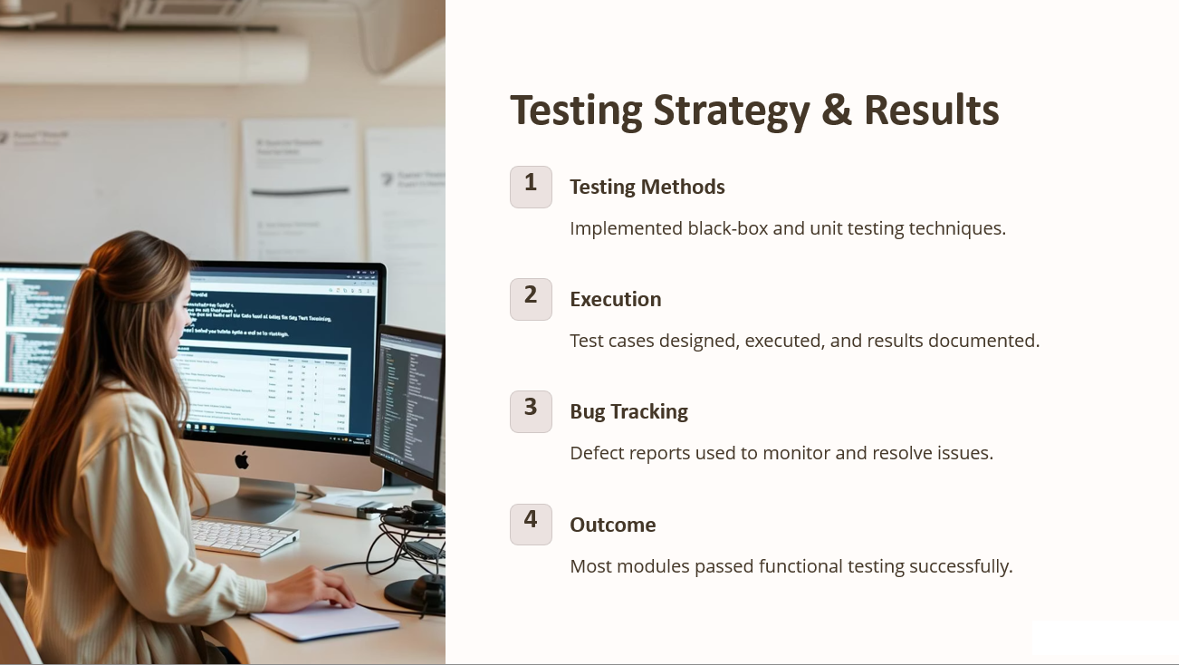
Results and discussion

Slide 10
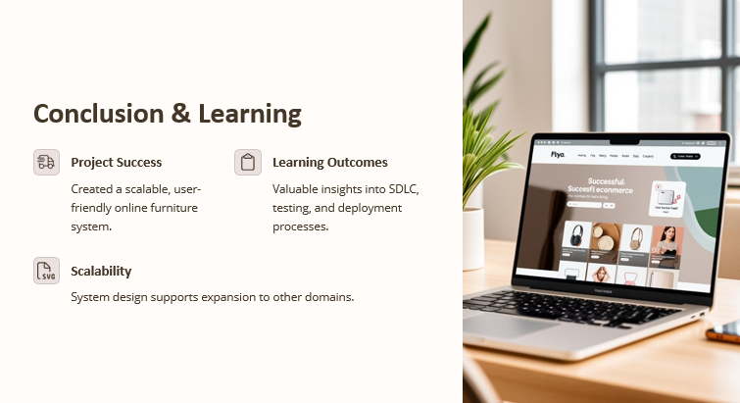

Slide 11
☺
Thanks You!

